Slide 1

Mobile Game Programming: A-Star(A*) Path Finding
jintaeks@dongseo.ac.kr
Division of Digital Contents, DSU
May 2018

Slide 2
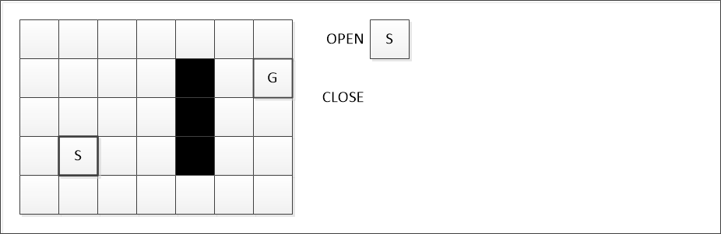
AStar(A*) Step by Step Example

Slide 3
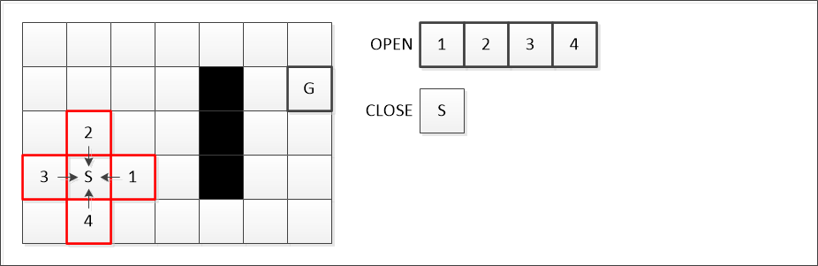

Slide 4
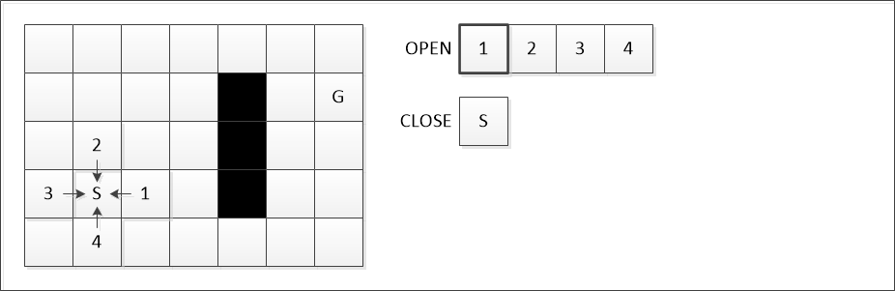

Slide 5
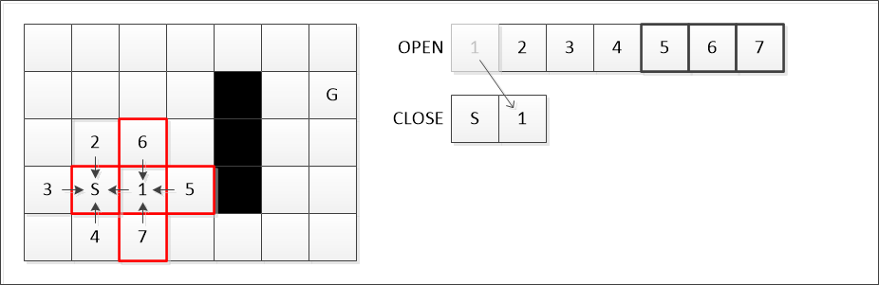

Slide 6
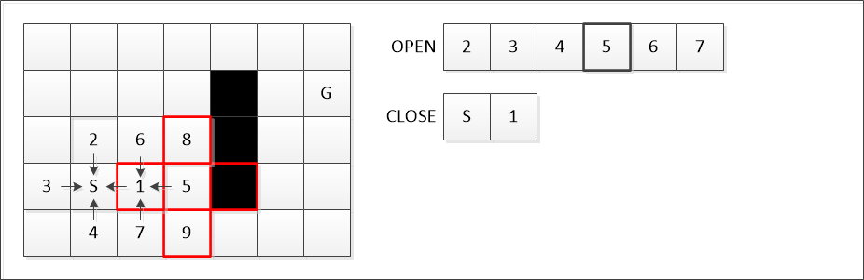

Slide 7
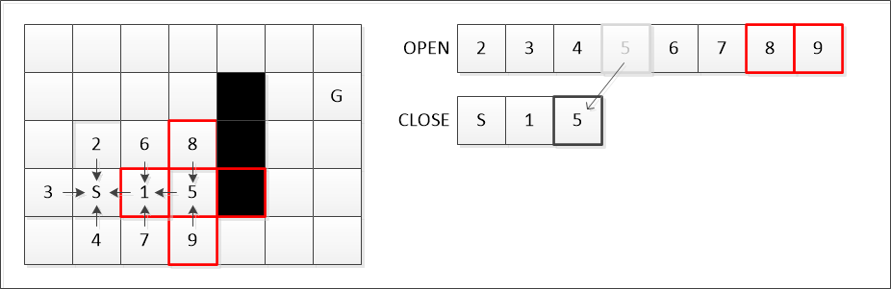

Slide 8
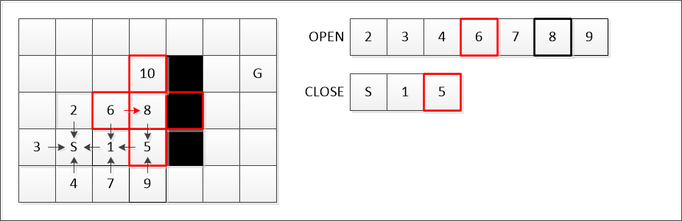

Slide 9
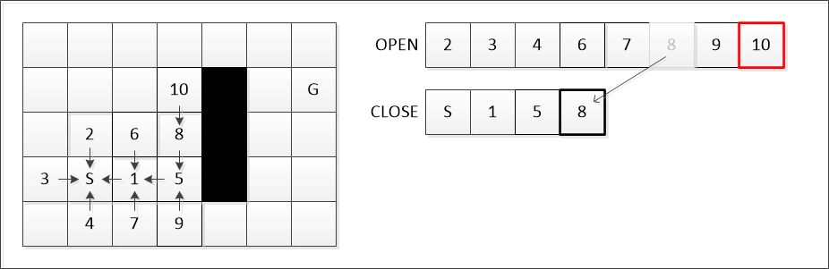

Slide 10
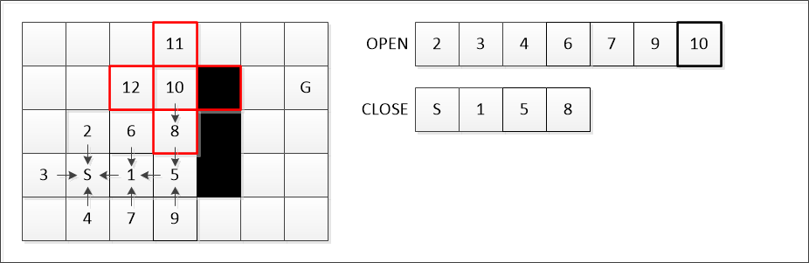

Slide 11
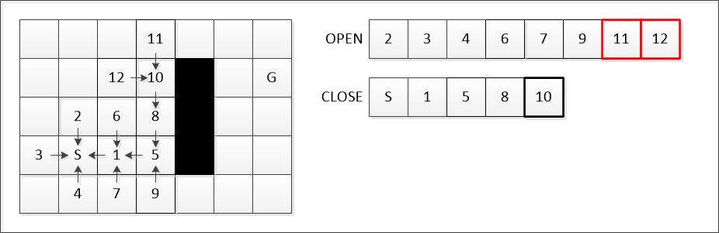

Slide 12
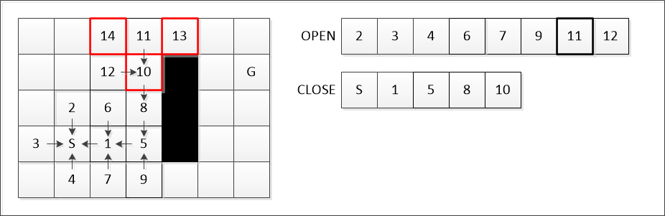

Slide 13
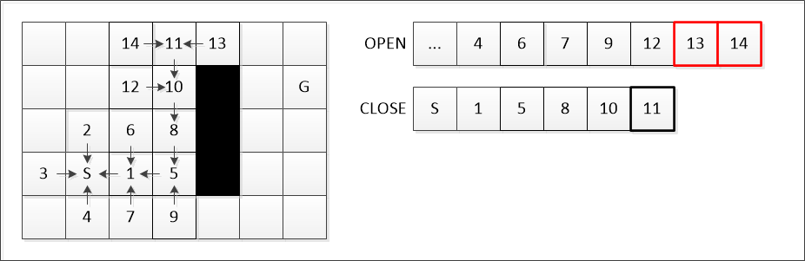

Slide 14
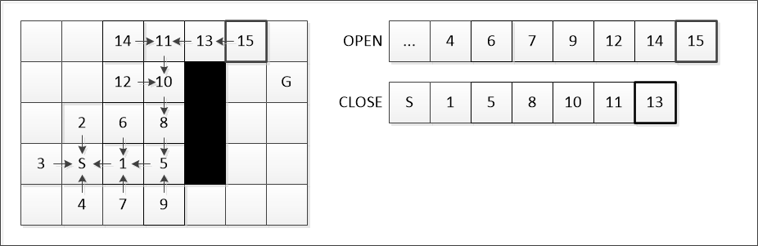

Slide 15
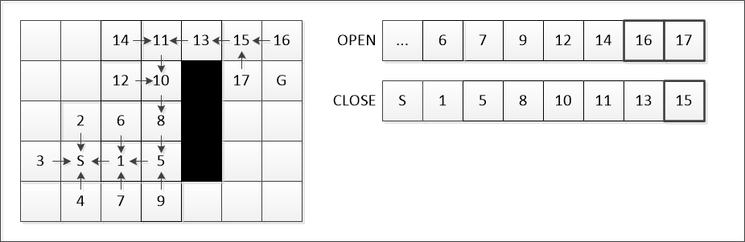

Slide 16
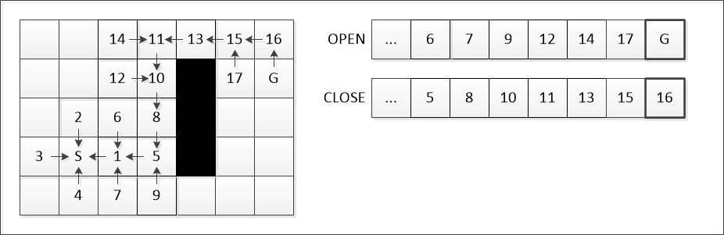

Slide 17
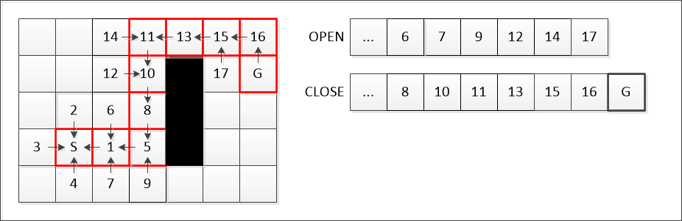

Slide 18
Add the starting node to the open list.
Repeat the following steps:
Look for the node which has the lowest f on the open list. Refer to this node as the current node.
Switch(move) it to the closed list.
For each reachable node from the current node
If it is on the closed list, ignore it.
If it isn’t on the open list, add it to the open list. Make the current node the parent of this node. Record the f, g, and h value of this node.
If it is on the open list already, check to see if this is a better path. If so, change its parent to the current node, and recalculate the f and g value.
Stop when
Add the target node to the closed list.
Fail to find the target node, and the open list is empty.
Tracing backwards from the target node to the starting node. That is your path.

Slide 19
the standard terminology
g(n) represents the exact cost from starting point to any point n
m_cost in AStarNode
h(n) represents the estimated cost from point n to the destination
m_heuristic in AStarNode
f(n)=g(n)+h(n).
m_total in AStarNode

Slide 20
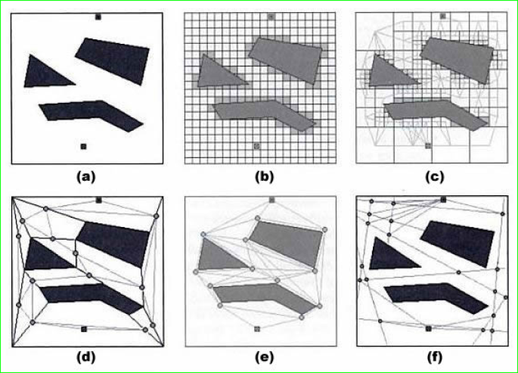
Real World Problem

Slide 21
rectangular grid (Fig. 2a)
quadtree (Fig. 2c)
convex polygons (Fig. 2d)
points of visibility (Fig. 2e)
generalized cylinders (Fig. 2f).

Slide 22
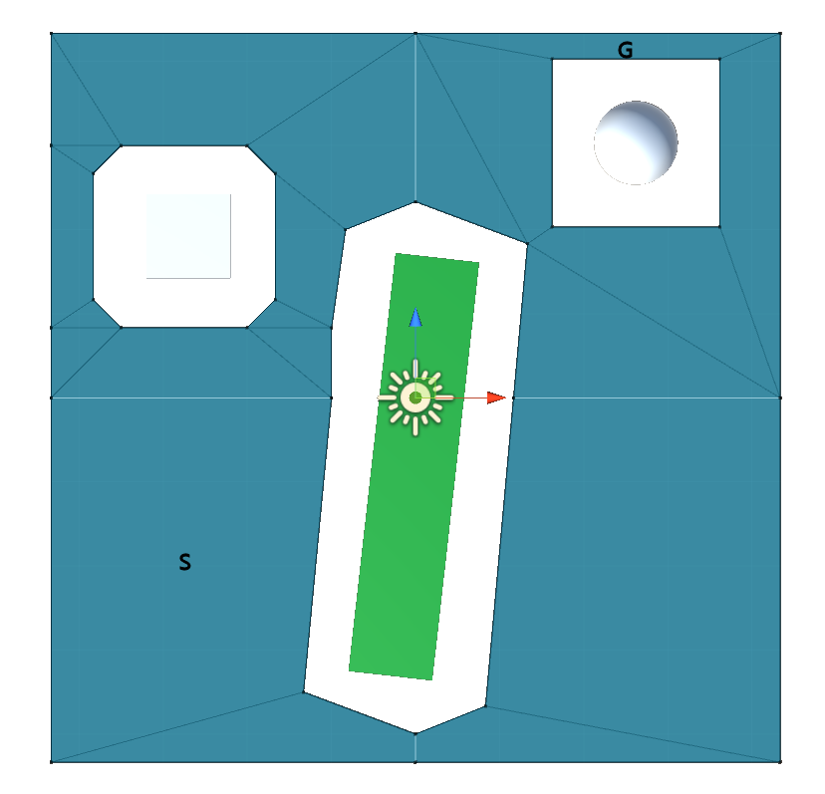

Slide 23
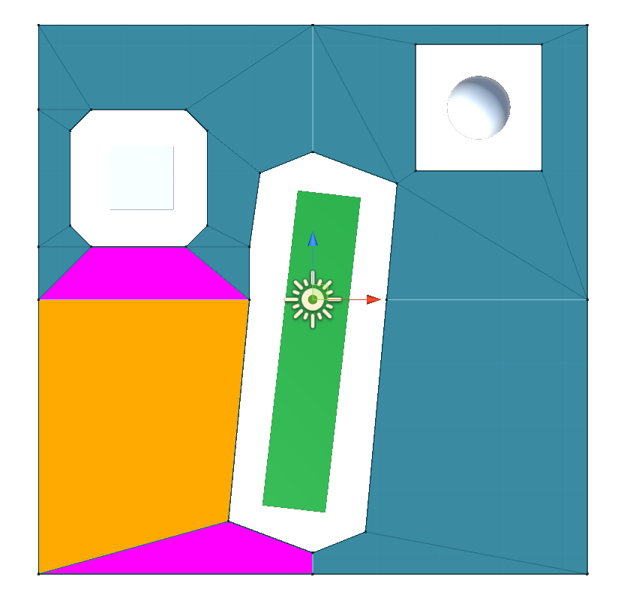

Slide 24
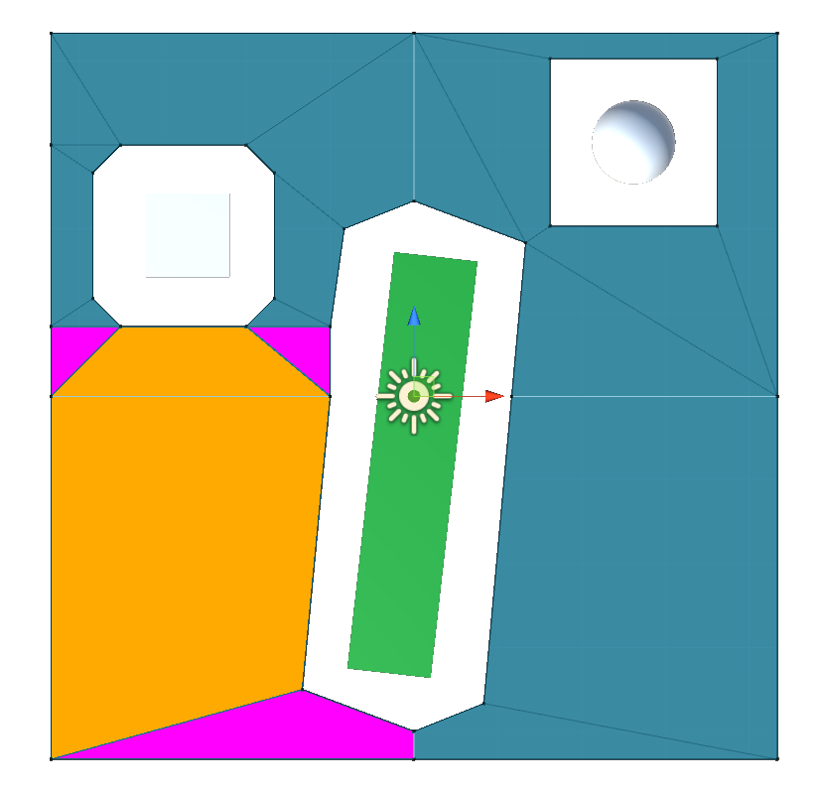

Slide 25
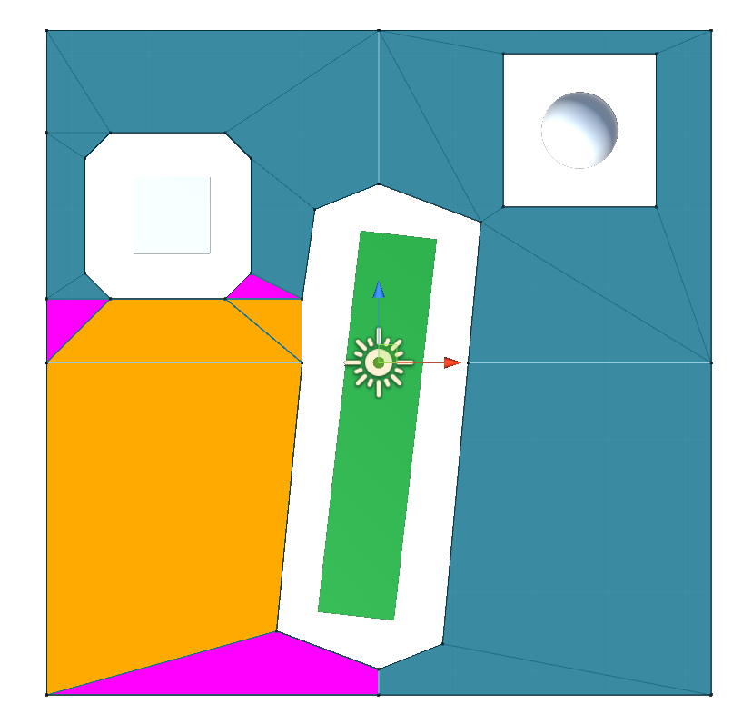

Slide 26
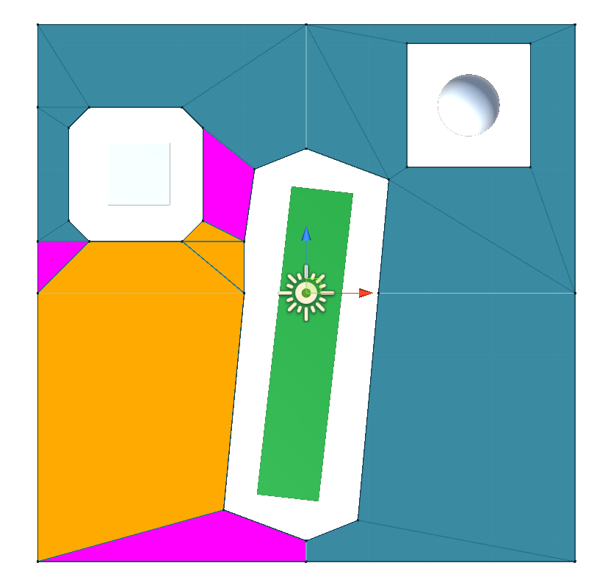

Slide 27
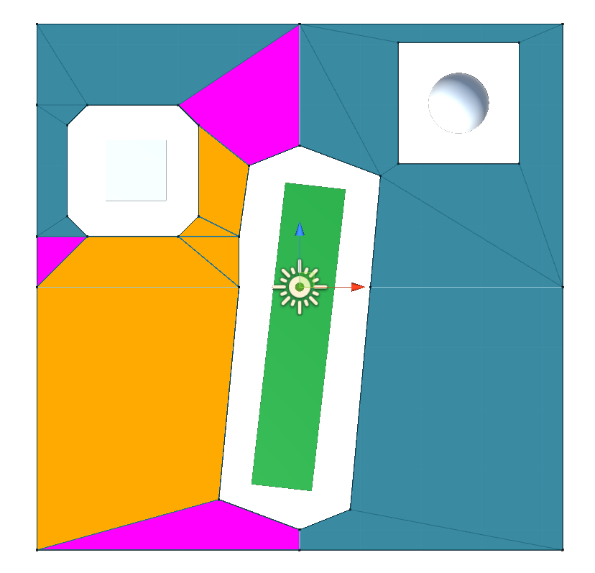

Slide 28
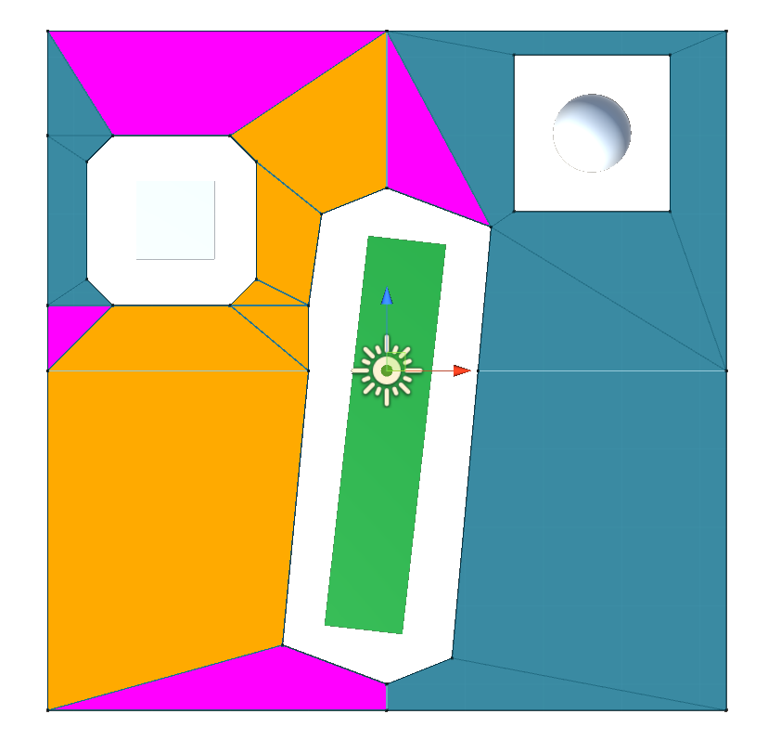

Slide 29
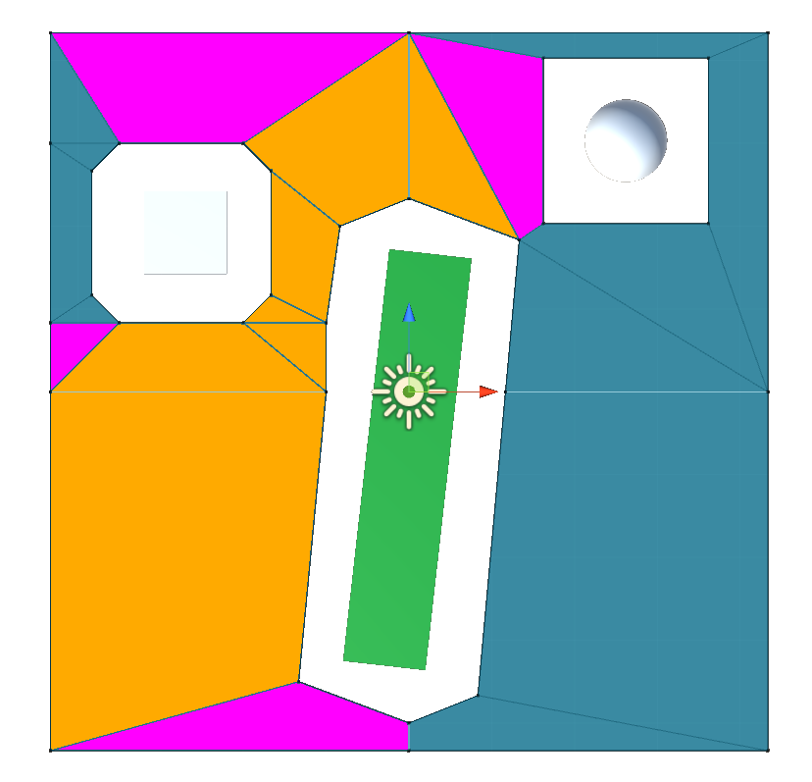

Slide 30
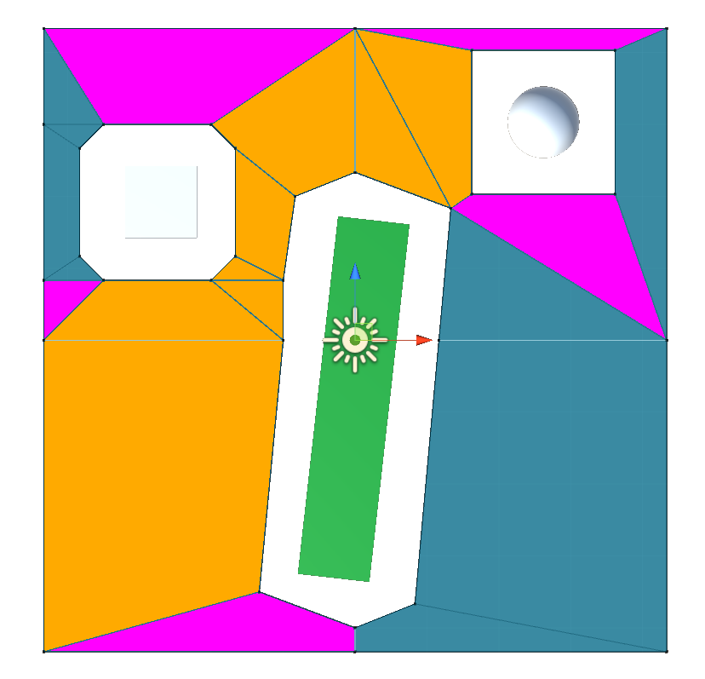

Slide 31
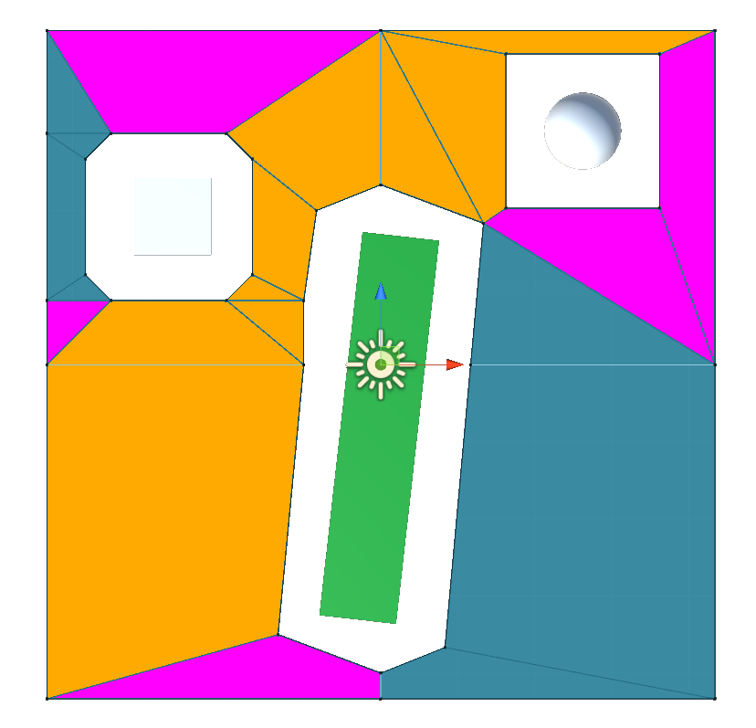

Slide 32
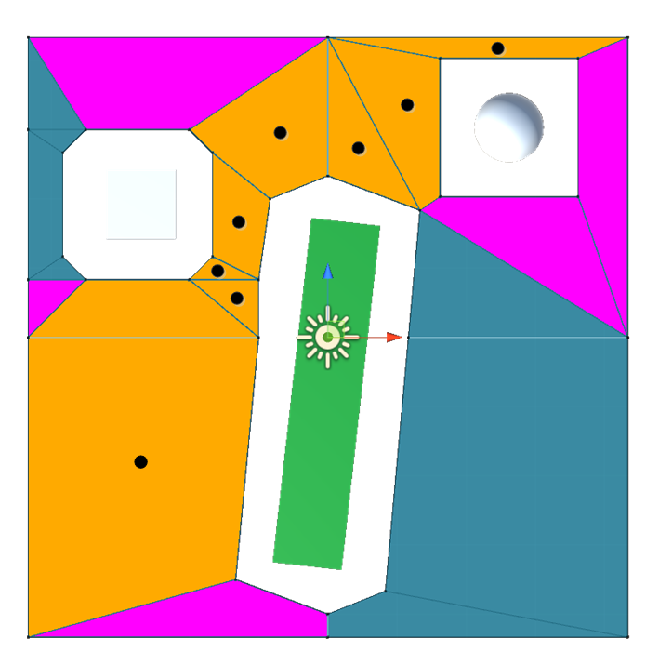

Slide 33
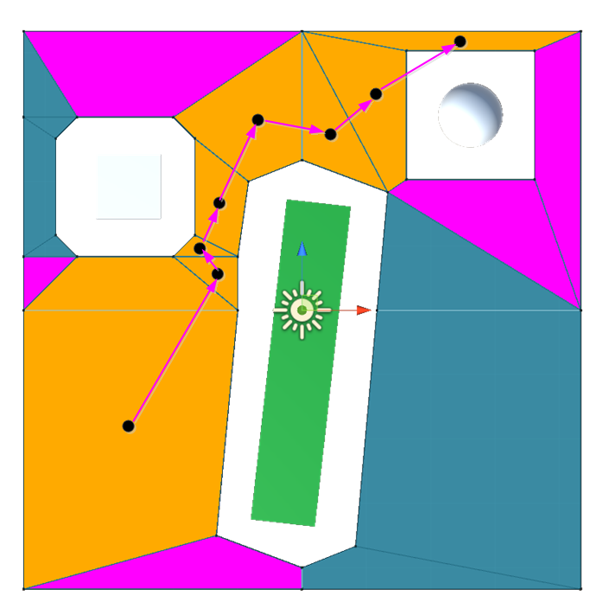

Slide 34
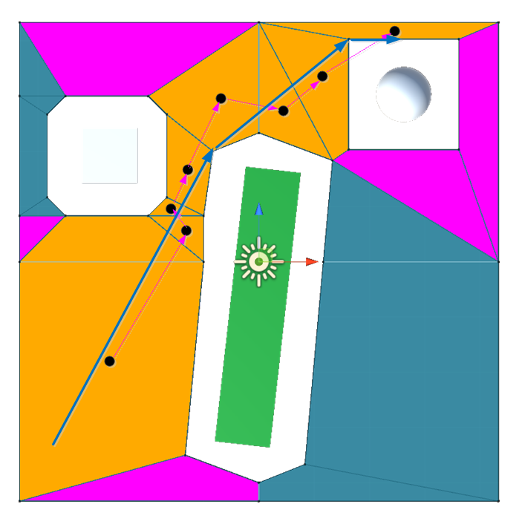

Slide 35
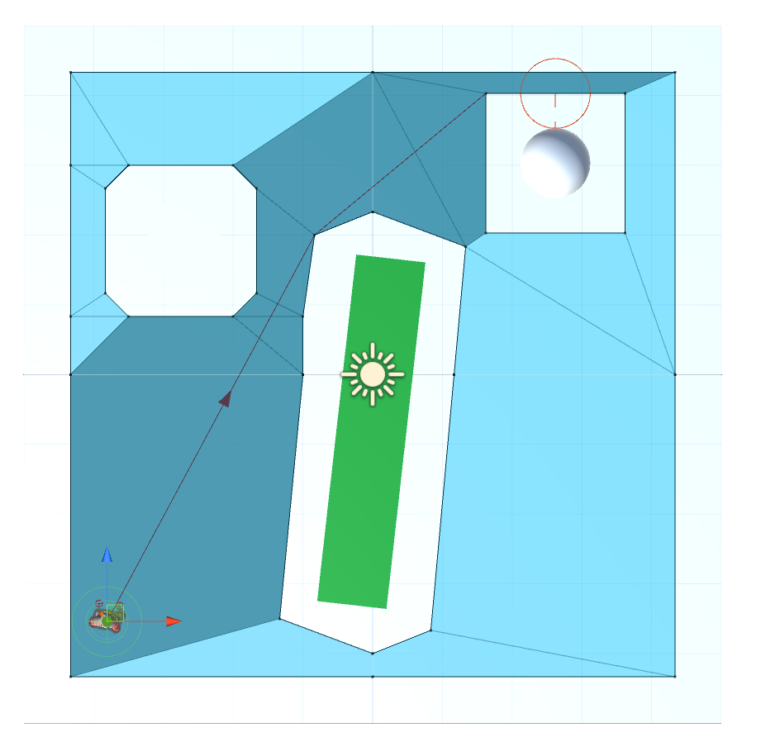

Slide 36
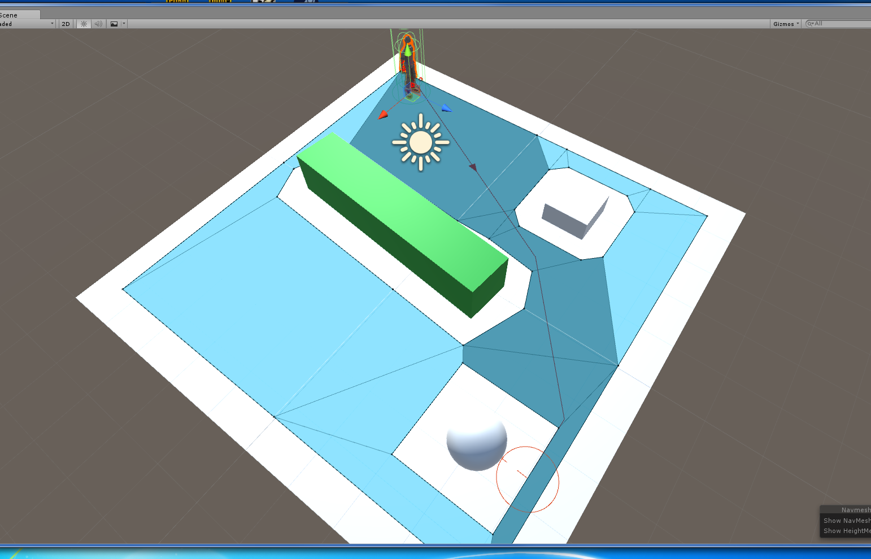

Slide 37



